Slide 1
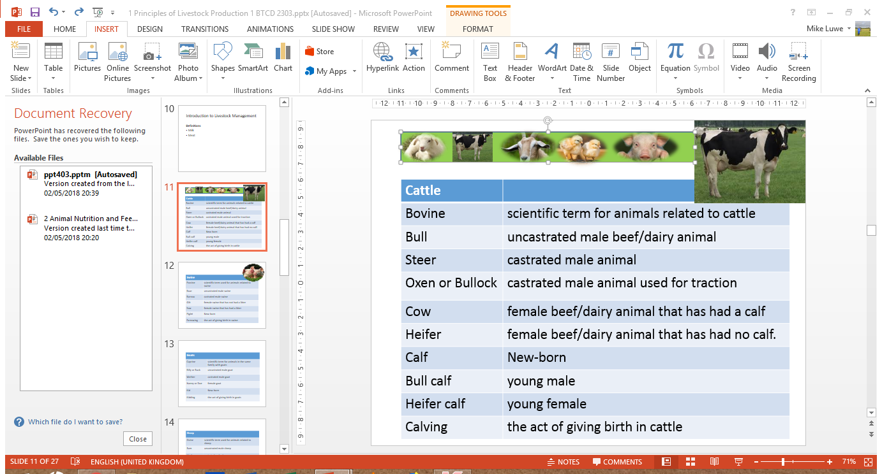
Hatchery Management
Michael Luwe
Veterinarian
Department of Animal Health and Livestock Development

Slide 2
1. Hatchery Design
Activities done in hatchery
Hatchery design
Egg selection for hatching
Storage of hatching eggs
Hatchery sanitation
Egg setting
Incubation
Candling
Egg transfer
Chick pull and processing
Siting – well isolated from poultry houses.
Allow one-way flow of work and traffic.
Easy to clean
Good insulation
Serviced with:
Receiving area
Egg store
Fumigation facilities
Candling room and facilities
Chick holding area and packaging facilities
Disposal area

Slide 3
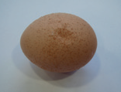
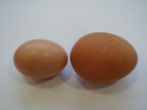
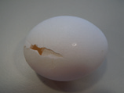
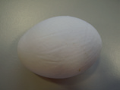
2. Selecting Eggs for Hatching
Good quality eggs should match the following:
uniform size (ideal size is 50 – 70g).
Clean dry eggs with shells which are not cracked.
Well shaped
No double yolk or very large
Notes:
Floor eggs are not regarded as good hatching eggs. It is very likely that they have already been contaminated by manure contact, before they can be collected, cleaned and disinfected.
The freshly laid egg has the temperature of the hen’s body (41 °C) and the egg surface is slightly wet. Cooling down to house temperature causes a contraction of the egg contents leading to air entering the egg which creates the air cell.

Slide 4
3. Storage of Hatching Eggs
Egg collection has to be done more frequently to avoid the embryo remaining at a temperature between 27 °C and 37 °C for too long a time.
Store hatching eggs on shelves at temperatures of about 16 – 21 º C.
The longer eggs are to be stored, the lower the storage temperature and vice versa.
In most layer hatcheries, it is common practice to store the eggs up to 10 days. For this storage length, the recommended temperature is 16 – 18 °C.
Eggs should be stored with their pointed end downwards.
Relative humidity should be 70 – 80%.
Notes:
For storage beyond 10 days we do not recommend a temperature far below of 16 °C.
In most situations this is not cost efficient and creates other problems when it comes to egg setting (egg sweating, long pre-warming time).
Condensation on the eggs should be avoided by any means. It allows microorganism to multiply on the wet surface, penetrate the shell and contaminate the egg.

Slide 5
4. Hatchery Sanitation
Hatching eggs need to be disinfected, as micro organisms multiply rapidly in the warm and humid climate of a hatchery.
Devise a sanitation program to control contamination.
Fumigation with formalin is no longer recommended as it is harmful to the embryo, increasing early embryonic death, and it is hazardous to human health.
Use glutaraldehyde or quaternary ammonia compounds on stabilized hydrogen peroxide and peracetic acid or just hydrogen peroxide that have the same effectiveness.

Slide 6
5. Egg Setting
Pre-warming, often also called pre-heating, is a procedure after storage and before setting during which the egg temperature is slowly increased to approximately 25 °C.
Provide good air circulation and allow 6 to 12 hours for pre-warming.
Incubation time influenced by:
Temperature of incubation – modified according to temperature and size.
Age of the eggs – for eggs stored over 6days, allow 1hr/day of storage
Size of the eggs – the larger the egg the longer the time
Notes:
To avoid temperature shock to the embryo and consequent condensation on the shell, eggs should be removed from the egg room and pre-warmed before setting.

Slide 7
6. Incubation
Incubation Periods
Species | Time
Chicken | 21 days
Quails (Coturnix) | 17 days
Turkeys | 28 days
Guinea fowls | 28 days
Ducks | 28 days
Types of Incubators
Automated incubators
Manual incubators
Pack the eggs on setters with the tip pointing downwards
Eggs must be turned 3 – 5days daily from first day to
18th day of incubation – to prevent them from sticking.
Turning can be automated or done manually.
Eggs normally titled at an angle of 45º from the surface.
Put an X sign with a pencil on one side of the broad end of the egg for ease of identification during turning.
High mortalities experienced between 3rd and 5th days due to poor egg handling and poor nutrition of the parent stock.

Slide 8
Incubation (Conti….)
Transfer eggs from setters to hatcher trays on 18th day.
Never turn eggs after 18th day of incubation.
Maintain humidity of 55 – 62% for the first 18 days, and then 65 – 75% in the last three days.
Optimum temperature for incubation is 37 – 38 ^{O}C.
Short periods of low temperatures are not harmful to embryo – longer periods will slow down embryo development.
Good ventilation should be ensured since embryos use oxygen and release carbon dioxide.

Slide 9
7. Candling
Candling is a means of identifying infertile and early dead embryos.
Trays of eggs are passed over a strong light source which clearly shows infertile and early dead embryos.
It can be done on 5 – 6th day and then 18th day of incubation or once during egg transfer.
Egg candling and transfer should not last longer than 30 minutes per trolley.
Sample each flock and if candling percentage exceeds 10 %, then all eggs should be candled, the clear eggs removed and hatcher trays refilled to 95 – 100 %.

Slide 10
8. Egg Transfer
Eggs are removed from the setter on 18th day of incubation and transferred to the hatcher trays.
Eggs can be candled at transfer in order to remove clears.
Poor handling may result in haemorrhages and ruptures.
9. Chick Pull and Processing
Take them off when most of them are dry and fluffed up.
Do not allow chicks to spend too long in the hatchers which may result in dehydration.
Upon pulling, separate chicks from debris, grade them into first quality and culls, and count into boxes.
Other activities which may also be done include:
🤌Sexing 🤌vaccination
Notes:
Egg transfer allows the egg to be laid on their sides to allow free movement of the chick out of the shell at hatching. Egg transfer also helps to keep the large quantity of fluff generated during hatching away from the clean areas of the hatchery.

Slide 11
Common Causes of Hatch Failure
Egg storage
Egg faults and shell damage
Incubation faults
Breeder nutrition
True infertility (flock age)
Diseases
Bacterial and mould contamination
Genetics

Slide 12
Some Hatching Problems and Possible Causes
Problem | Cause(s)
Hatching early | High temperature - 1 to 19 days Small eggs
Hatching late | Low temperatures or humidity - 1 to 19 days Egg storage Large eggs Low hatcher temperature
Sticky chicks | Temperature too high - 20 to 21 days Egg storage Broken eggs in the tray Inadequate turning
Unhealed navels | High temperatures - 1 to 19 days High humidity - 20 to 21 days Egg storage
Abnormal chicks | Crossed beak: Hereditary or virus infection Missing eyes: High temperatures or handling Wry neck: Nutrition Crooked toes: Temperature and nutrition Spraddle legs: Smooth hatcher trays

Slide 13
Summary of activities done in hatchery
Hatchery design
Egg selection for hatching
Storage of hatching eggs
Hatchery sanitation
Egg setting
Incubation
Candling
Egg transfer
Chick pull and processing

